Slide 1
Stream Cipher – RC4
This lecture is mainly based on the power point slides by Professor Lawrie Brown.
Notes:
Zili Shao

Slide 2


One-Time Pad
Developed by Gilbert Vernam in 1918, another name: Vernam Cipher
The key
  a truly random sequence of 0’s and 1’s
  the same length as the message
  use one time only
The encryption
  adding the key to the message modulo 2, bit by bit.
Encryption
Decryption
m_{i} : plain-text bits.
k_{i} : key (key-stream ) bits
c_{i} : cipher-text bits.

Slide 3
One-Time Pad
One-time pad is perfectly secure
But what is the practical problem?

Slide 4
One-Time Pad
Developed by Gilbert Vernam in 1918, another name: Vernam Cipher
The key
  a truly random sequence of 0’s and 1’s
  the same length as the message
  use one time only
The encryption
  adding the key to the message modulo 2, bit by bit.
Encryption
Decryption
m_{i} : plain-text bits.
k_{i} : key (key-stream ) bits
c_{i} : cipher-text bits.

Slide 5
One-Time pad practical Problem
Key-stream should be as long as plain-text
Key-stream will only used one time
  Do you have sufficient space to store your key-stream?
  How do you manage key distribution?
Truly random
  How?
Solution :
  Stream Ciphers
  Key-stream is generated from a relatively short secret key in a “pseudo-random” fashion.

Slide 6
Random Numbers
Many uses of random numbers in cryptography
  Nonce as Initialize Vector
  Session keys
  Public key generation
  Keystream for a one-time pad
In all cases its critical that these values be
  statistically random, uniform distribution, independent
  unpredictability of future values from previous values
Care needed with generated random numbers
Notes:
Random numbers play an important role in the use of encryption for various network security applications. In this section, we provide a brief overview of the use of random numbers in cryptography and network security and then focus on the principles of pseudorandom number generation. Getting good random numbers is important, but difficult. You don't want someone guessing the key you're using to protect your communications because your "random numbers" weren't (as happened in an early release of Netscape SSL). Traditionally, the concern in the generation of a sequence of allegedly random numbers has been that the sequence of numbers be random in some well-defined statistical sense (with uniform distribution & independent). In applications such as reciprocal authentication, session key generation, and stream ciphers, the requirement is not just that the sequence of numbers be statistically random but that the successive members of the sequence are unpredictable (so that it is not possible to predict future values having observed previous values). With "true" random sequences, each number is statistically independent of other numbers in the sequence and therefore unpredictable. However, as is discussed shortly, true random numbers are seldom used; rather, sequences of numbers that appear to be random are generated by some algorithm.

Slide 7
Pseudorandom Number Generators (PRNGs)
Often use deterministic algorithmic techniques to create “random numbers”
  although are not truly random
  can pass many tests of “randomness”
Known as “Pseudorandom Numbers”
Created by “Pseudorandom Number Generators (PRNGs)”

Slide 8
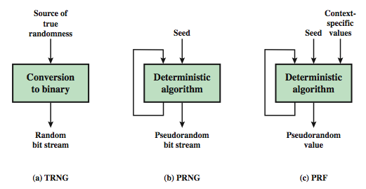
Random & Pseudorandom Number Generators
Notes:
Stallings Figure 7.1 contrasts a true random number generator (TRNG) with two forms of pseudorandom number generators. A TRNG takes as input a source that is effectively random; the source is often referred to as an entropy source. In contrast, a PRNG takes as input a fixed value, called the seed, and produces a sequence of output bits using a deterministic algorithm. Typically, as shown, there is some feedback path by which some of the results of the algorithm are fed back as input as additional output bits are produced. The important thing to note is that the output bit stream is determined solely by the input value or values, so that an adversary who knows the algorithm and the seed can reproduce the entire bit stream.
Figure 7.1 shows two different forms of PRNGs, based on application;
• Pseudorandom number generator: An algorithm that is used to produce an open-ended sequence of bits is referred to as a PRNG. A common application for an open-ended sequence of bits is as input to a symmetric stream cipher, as discussed in Section 7.4. Also, see Figure 3.1a.
• Pseudorandom function (PRF): A PRF is used to produced a pseudorandom string of bits of some fixed length. Examples are the symmetric encryption keys and nonces. Typically, the PRF takes as input a seed plus some context specific values, such as a user ID or an application ID.

Slide 9
PRNG Requirements
Randomness
  uniformity, scalability, consistency
Unpredictability
  forward & backward Unpredictability
  use same tests to check
Characteristics of the seed
  Secure
  if known adversary can determine output
  so must be random or pseudorandom number

Slide 10
Stream Ciphers
Generalization of one-time pad
Process message bit by bit (as a stream)
Have a pseudo random keystream
Combined (XOR) with plaintext bit by bit
Randomness of stream key completely destroys statistically properties in message
  C_{i} = M_{i} XOR StreamKey_{i}
But must never reuse stream key
  otherwise can recover messages
CEG 260, Meilin Liu
Notes:
Zili Shao
A typical stream cipher encrypts plaintext one byte (or bit) at a time, usually by XOR’ing with a pseudo-random keystream. The stream cipher is similar to the one-time pad discussed in Chapter 2. The difference is that a one-time pad uses a genuine random number stream, whereas a stream cipher uses a pseudorandom number stream. But rely on the randomness of stream key completely destroys statistically properties in message. However, you must never reuse a stream key since otherwise you can recover messages (as with a book cipher).

Slide 11

Stream Cipher Structure
CEG 260, Meilin Liu
Notes:
Zili Shao
Stallings Figure 6.8 illustrates the general structure of a stream cipher, where a key is input to a pseudorandom bit generator that produces an apparently random keystream of bits, and which are XOR’d with message to encrypt it, and XOR’d again to decrypt it by the receiver.

Slide 12
Stream Cipher Properties
Some design considerations are:
  long period with no repetitions
  statistically random
  depends on large enough key
  large linear complexity
Properly designed, can be as secure as a block cipher with same size key
But usually simpler & faster
CEG 260, Meilin Liu
Notes:
Zili Shao
[KUMA97] lists the following important design considerations for a stream cipher:
The encryption sequence should have a large period, the longer the period of repeat the more difficult it will be to do cryptanalysis.
The keystream should approximate the properties of a true random number stream as close as possible, the more random-appearing the keystream is, the more randomized the ciphertext is, making cryptanalysis more difficult.
To guard against brute-force attacks, the key needs to be sufficiently long. The same considerations as apply for block ciphers are valid here .Thus, with current technology, a key length of at least 128 bits is desirable.
With a properly designed pseudorandom number generator, a stream cipher can be as secure as block cipher of comparable key length. The primary advantage of a stream cipher is that stream ciphers are almost always faster and use far less code than do block ciphers.

Slide 13
RC4
A proprietary cipher owned by RSA DSI
Another Ron Rivest design, simple but effective
Variable key size, byte-oriented stream cipher
Widely used (web SSL/TLS, wireless WEP (Wired Equivalent Privacy) )
Key forms random permutation of all 8-bit values
Uses that permutation to scramble input info processed a byte at a time
CEG 260, Meilin Liu
Notes:
Zili Shao
RC4 is a stream cipher designed in 1987 by Ron Rivest for RSA Security. It is a variable key-size stream cipher with byte-oriented operations. The algorithm is based on the use of a random permutation. Analysis shows that the period of the cipher is overwhelmingly likely to be greater than 10^100. Eight to sixteen machine operations are required per output byte, and the cipher can be expected to run very quickly in software. RC4 is probably the most widely used stream cipher. It is used in the SSL/TLS secure web protocol, & in the WEP & WPA wireless LAN security protocols. RC4 was kept as a trade secret by RSA Security, but in September 1994 was anonymously posted on the Internet on the Cypherpunks anonymous remailers list. In brief, the RC4 key is ued to form a random permutation of all 8-bit values, it then uses that permutation to scramble input info processed a byte at a time.

Slide 14
RC4 Key Schedule
Starts with an array S of numbers: 0..255
Use key to well and truly shuffle
S forms internal state of the cipher
  for i = 0 to 255 do
    S[i] = i
    T[i] = K[i mod keylen])
  j = 0
  for i = 0 to 255 do
    j = (j + S[i] + T[i]) (mod 256)
    swap (S[i], S[j])
CEG 260, Meilin Liu
Notes:
Zili Shao
The RC4 key schedule initialises the state S to the numbers 0..255, and then walks through each entry in turn, using its current value plus the next byte of key to pick another entry in the array, and swaps their values over. After doing this 256 times, the result is a well and truly shuffled array. The total number of possible states is 256! - a truly enormous number, much larger even than the 2048-bit (256*8) max key allowed can select.

Slide 15
RC4 Encryption
Encryption continues shuffling array values
Sum of shuffled pair selects "stream key" value from permutation
XOR S[t] with next byte of message to en/decrypt
  i = j = 0
  for each message byte M_{i}
    i = (i + 1) (mod 256)
    j = (j + S[i]) (mod 256)
    swap(S[i], S[j])
    t = (S[i] + S[j]) (mod 256)
    C_{i} = M_{i} XOR S[t]
CEG 260, Meilin Liu
Notes:
Zili Shao
To form the stream key for en/decryption (which are identical), RC4 continues to shuffle the permutation array S by continuing to swap each element in turn with some other entry, and using the sum of these two entry values to select another value from the permutation to use as the stream key, which is then XOR’d with the current message byte.

Slide 16
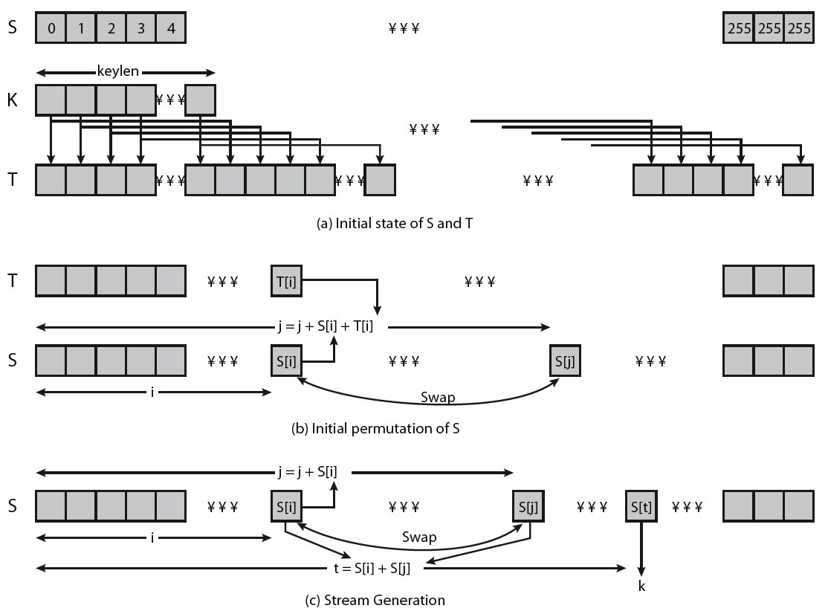
RC4 Overview
CEG 260, Meilin Liu
Notes:
Zili Shao
Stallings Figure 6.9 illustrates the general structure of RC4.

Slide 17
RC4-based Usage
WEP
WPA default
Bit Torrent Protocol Encryption
Microsoft Point-to-Point Encryption
SSL (optionally)
SSH (optionally)
Remote Desktop Protocol
Kerberos (optionally)

Slide 18
RC4 Security
Claimed secure against known attacks
  have some analyses, none practical
Result is very non-linear
Since RC4 is a stream cipher, must never reuse a key
Have a concern with WEP (Wired Equivalent Privacy), but due to key handling rather than RC4 itself
CEG 260, Meilin Liu
Notes:
Zili Shao
A number of papers have been published analyzing methods of attacking RC4, but none of these approaches is practical against RC4 with a reasonable key length, such as 128 bits.
A more serious problem occurs in its use in the WEP protocol, not with RC4 itself but the way in which keys are generated for use as input to RC4.
Currently RC4 its regarded as quite secure, if used correctly, with a sufficiently large key.

